Slide 1
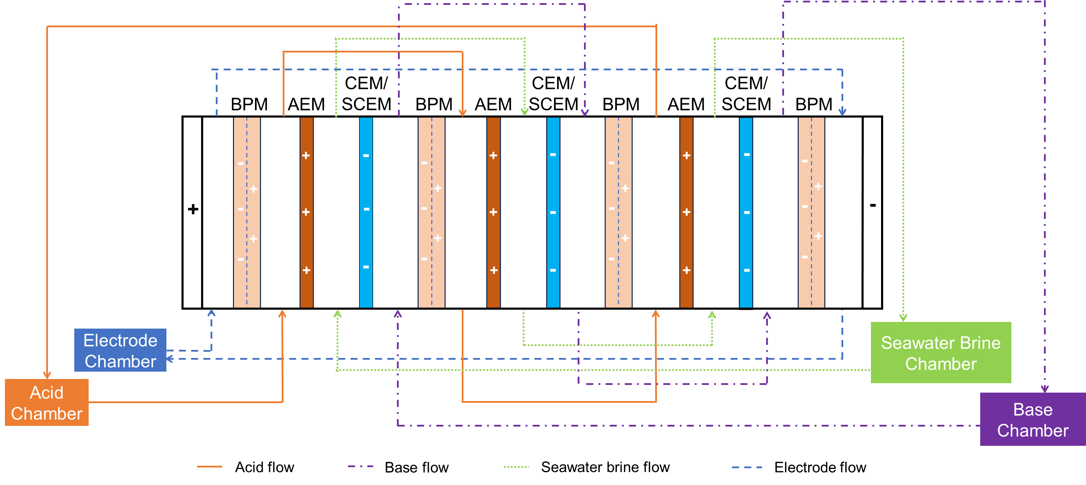
Outline
Introduction
Material and Methods
2.1 Lab-scale BMED Stack
The figure of setup
2.2 Protocol
2.3 Scaling Characterization and BMED Performance Analysis
2.3.1 Scaling characterization
SEM, EDS, XRD, turbidimeter
Calculation of scaling(R_{Mg}, R_{Ca}, mass of scaling)
2.3.2 BMED Performance Analysis
Conductivity, voltage, pH
Energy consumption
SI

Slide 2
3. Results and Discussion
3.1 Scaling in BMED
3.1.1 Scaling characterization in BMED system
When treating NaCl, there is no scaling →SEM and EDS
When treating SWB, there is severe scaling in the chamber and membrane
Chamber → Turbidity before and after experiments
Membrane → photo of membranes after experiments
Explore the scaling formation mechanism
Where scaling is formed → SEM and EDS of each membrane surface/cross-section
CEM facing SWBC
CEM facing BC
BPM facing BC
What is the composition → XRD, SEM&EDS of crystal
Why scaling is formed
CEM facing SWBC: Water splitting (major) → pH decrease in salt chamber; OH⁻ leakage (minor)→ transport number decrease (membrane deformation, crystal block…)
CEM facing BC: divalent ion transport
BPM facing BC: High concentration of OH⁻
Conclusion

Slide 3
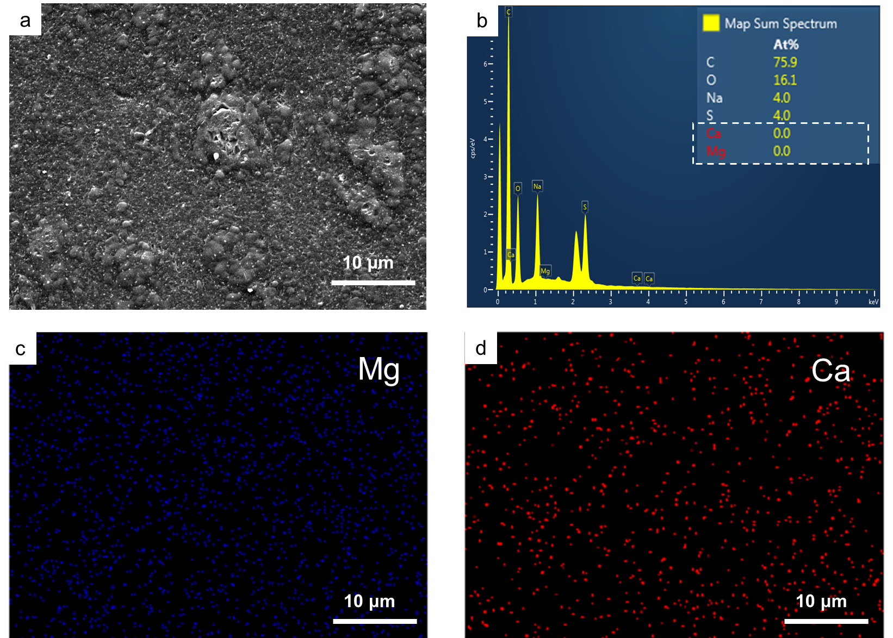
3. Results and Discussion
3.1 Scaling in BMED
3.1.1 Scaling characterization in BMED system
When treating NaCl, there is no scaling →SEM and EDS
SI

Slide 4
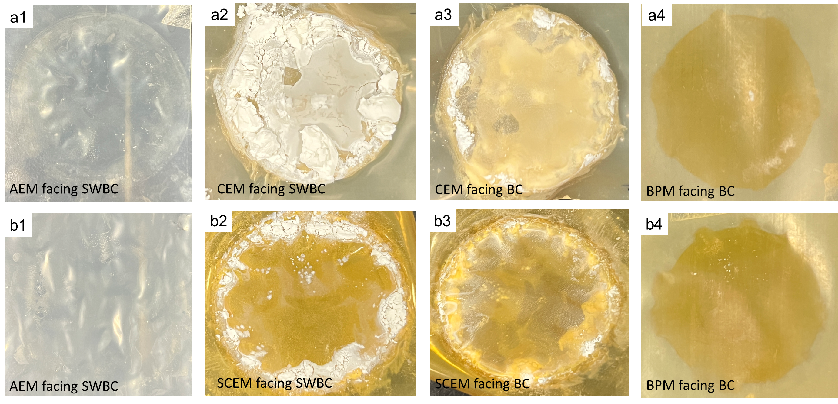
3. Results and Discussion
3.1 Scaling in BMED
3.1.1 Scaling characterization in BMED system
When treating NaCl, there is no scaling →SEM and EDS
When treating SWB, there is severe scaling in the chamber and membrane
Chamber → Turbidity before and after experiments
Membrane → photo of membranes after experiments
SI
SI

Slide 5
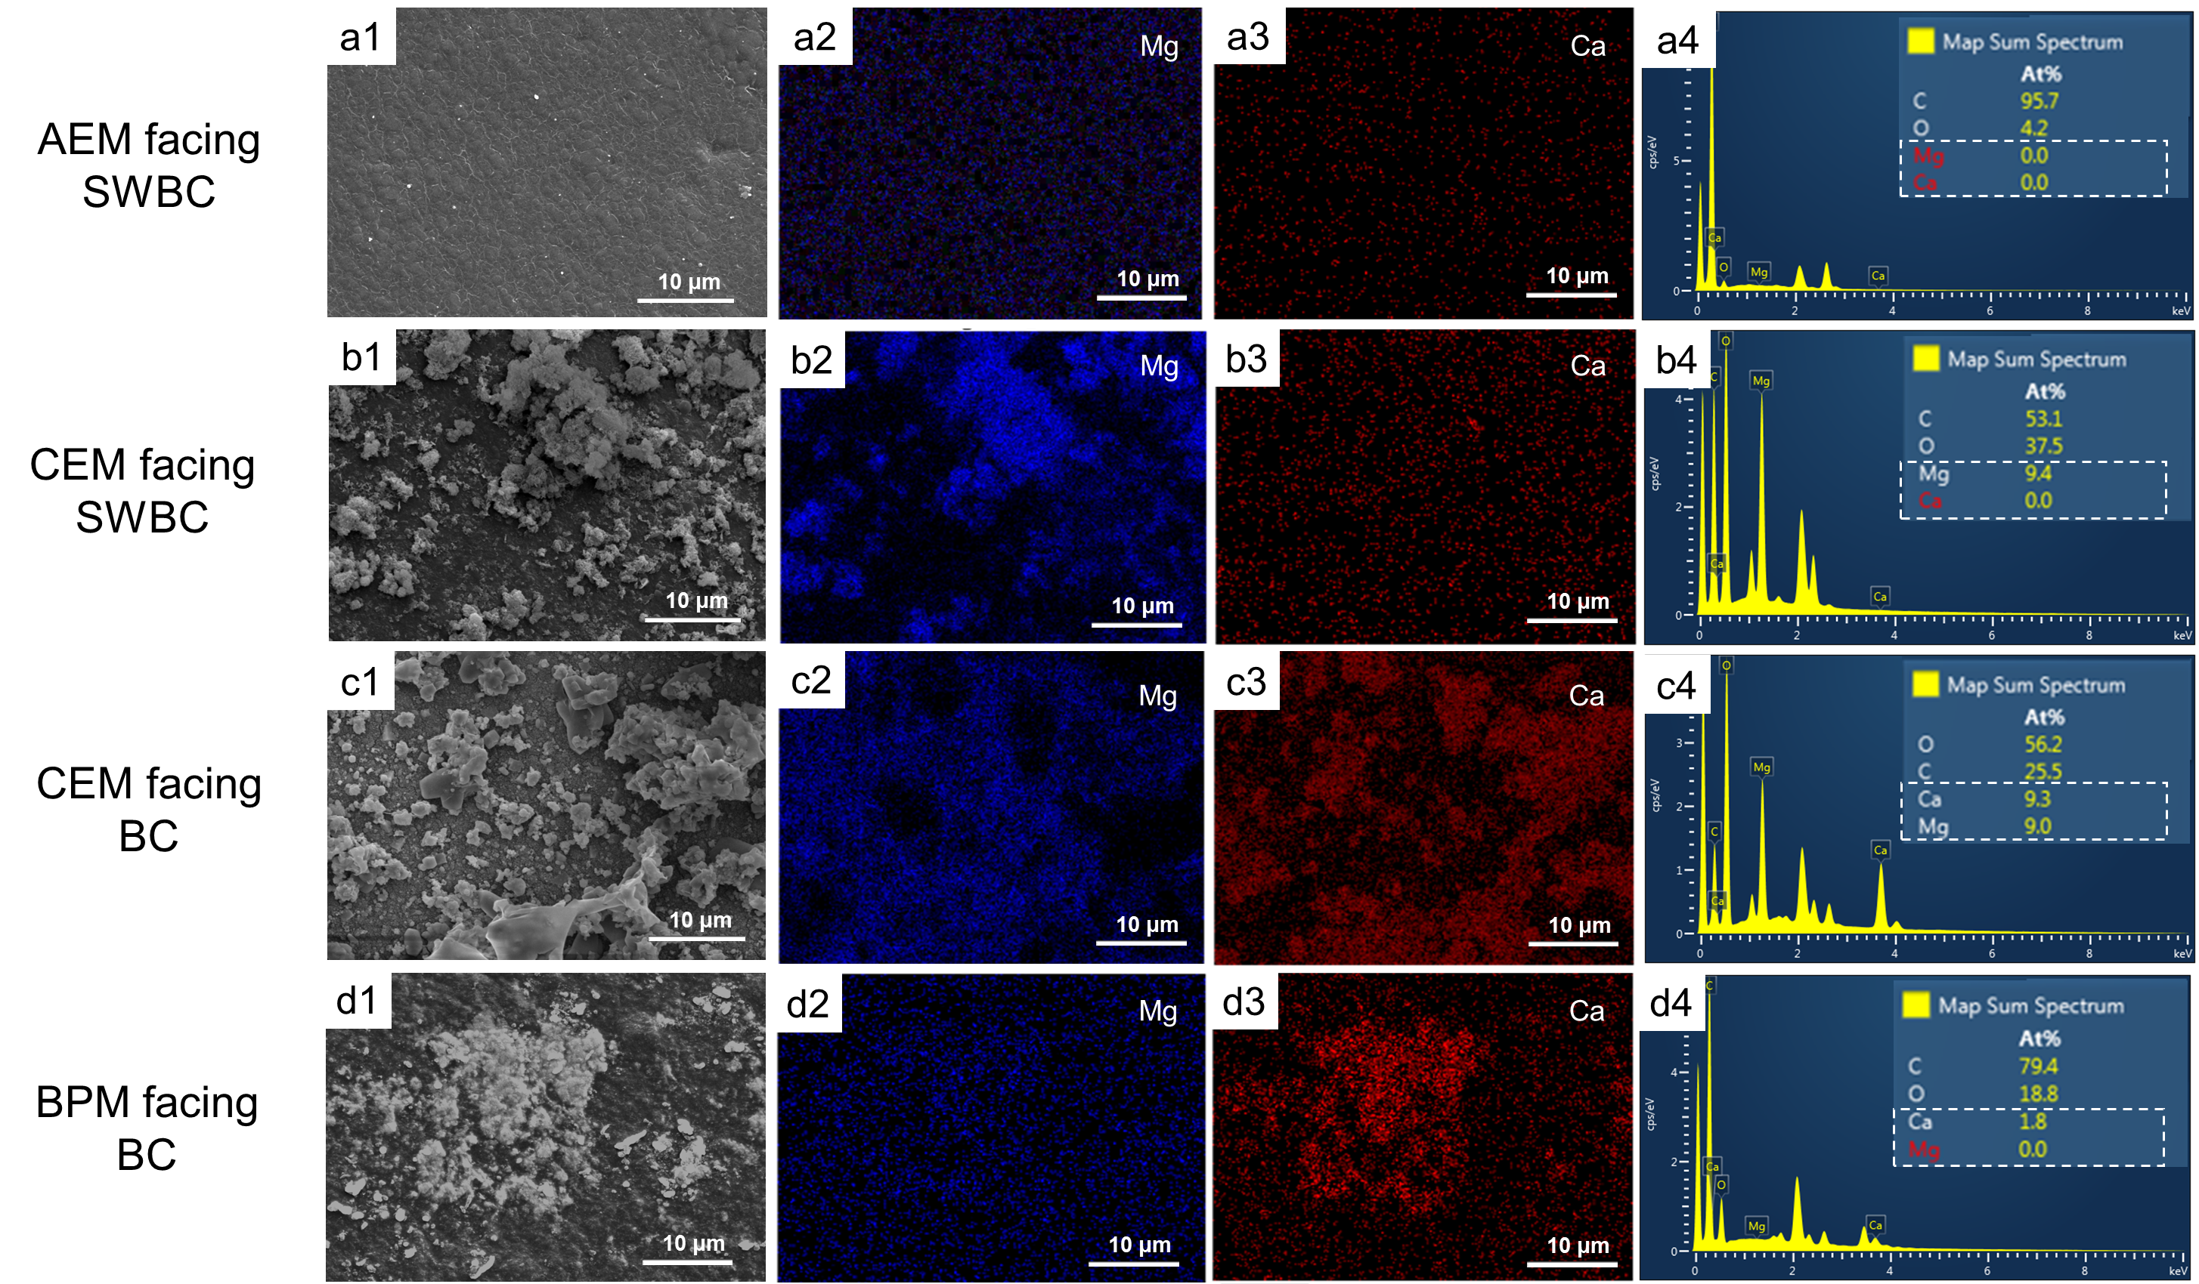
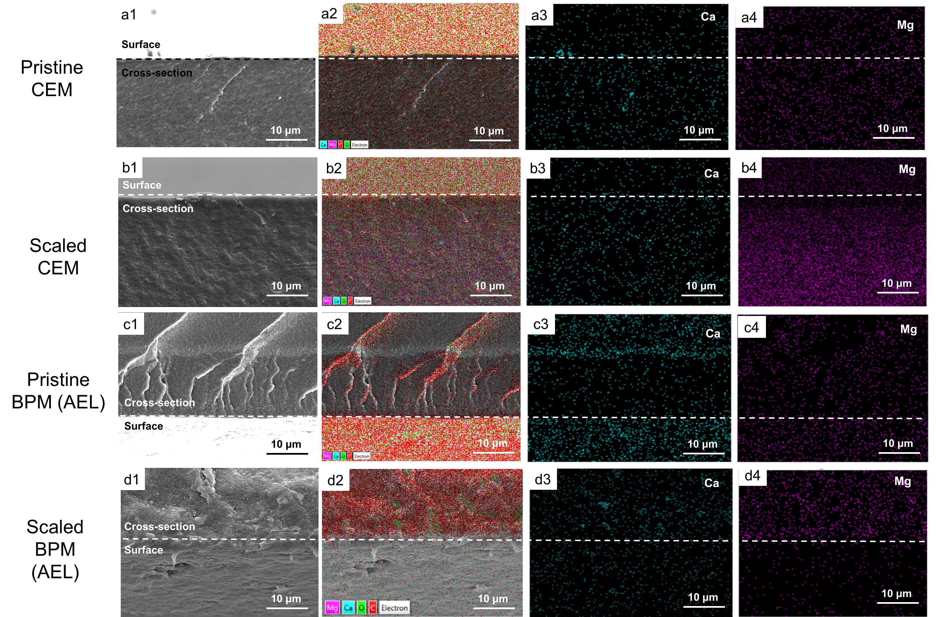
3. Results and Discussion
3.1 Scaling in BMED
3.1.1 Scaling characterization in BMED system
When treating NaCl, there is no scaling →SEM and EDS
When treating SWB, there is severe scaling in the chamber and membrane
Chamber → Turbidity before and after experiments
Membrane → photo of membranes after experiments
Explore the scaling formation mechanism
Where scaling is formed → SEM and EDS of each membrane surface/cross-section
CEM facing SWB, CCEM facing BC, BPM facing BC

Slide 6
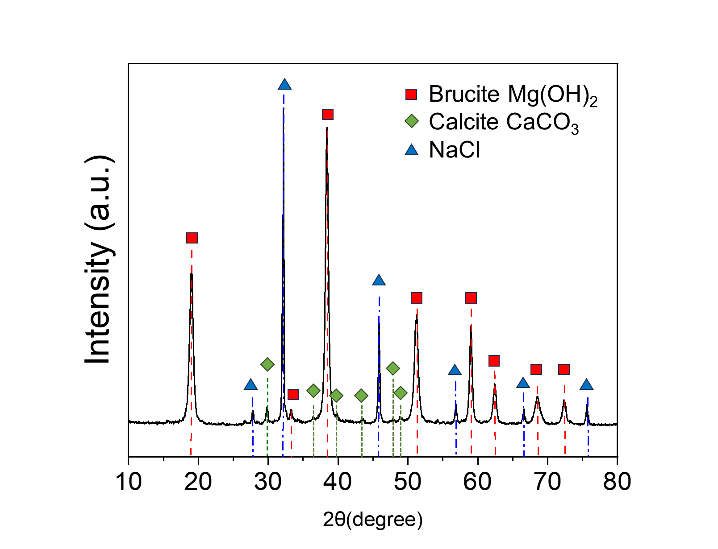
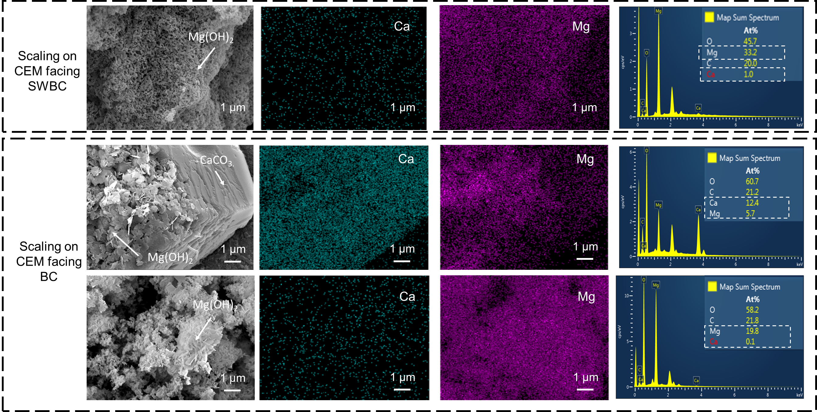
3. Results and Discussion
3.1 Scaling in BMED
3.1.1 Scaling characterization in BMED system
When treating NaCl, there is no scaling →SEM and EDS
When treating SWB, there is severe scaling in the chamber and membrane
Chamber → Turbidity before and after experiments
Membrane → photo of membranes after experiments
Explore the scaling formation mechanism
Where scaling is formed → SEM and EDS of each membrane surface/cross-section
CEM facing SWBC, CEM facing BC, BPM facing BC
What is the composition → XRD, SEM&EDS of crystal

Slide 7
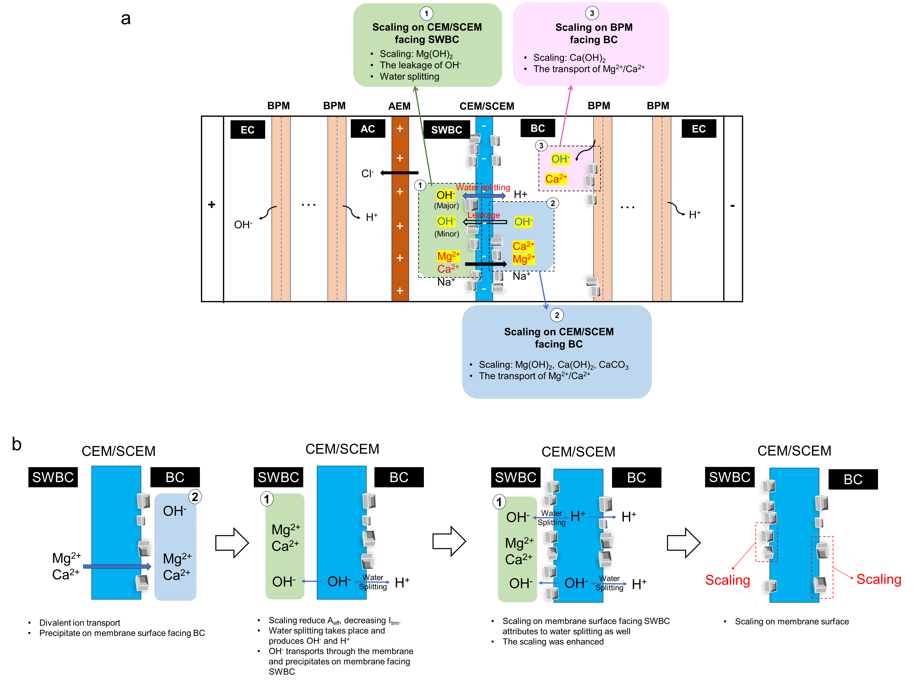
3. Results and Discussion
3.1 Scaling in BMED
3.1.1 Scaling characterization in BMED system
When treating NaCl, there is no scaling →SEM and EDS
When treating SWB, there is severe scaling in the chamber and membrane
Chamber → Turbidity before and after experiments
Membrane → photo of membranes after experiments
Explore the scaling formation mechanism
Where scaling is formed
CEM facing SWBC
CEM facing BC
BPM facing BC
What is the composition
Why scaling is formed
CEM facing SWBC:
Water splitting (major) → pH decrease in salt chamber;
OH⁻ leakage (minor)→ transport number decrease
(membrane deformation, crystal block…)
CEM facing BC: divalent ion transport
BPM facing BC: High concentration of OH⁻
Conclusion

Slide 8
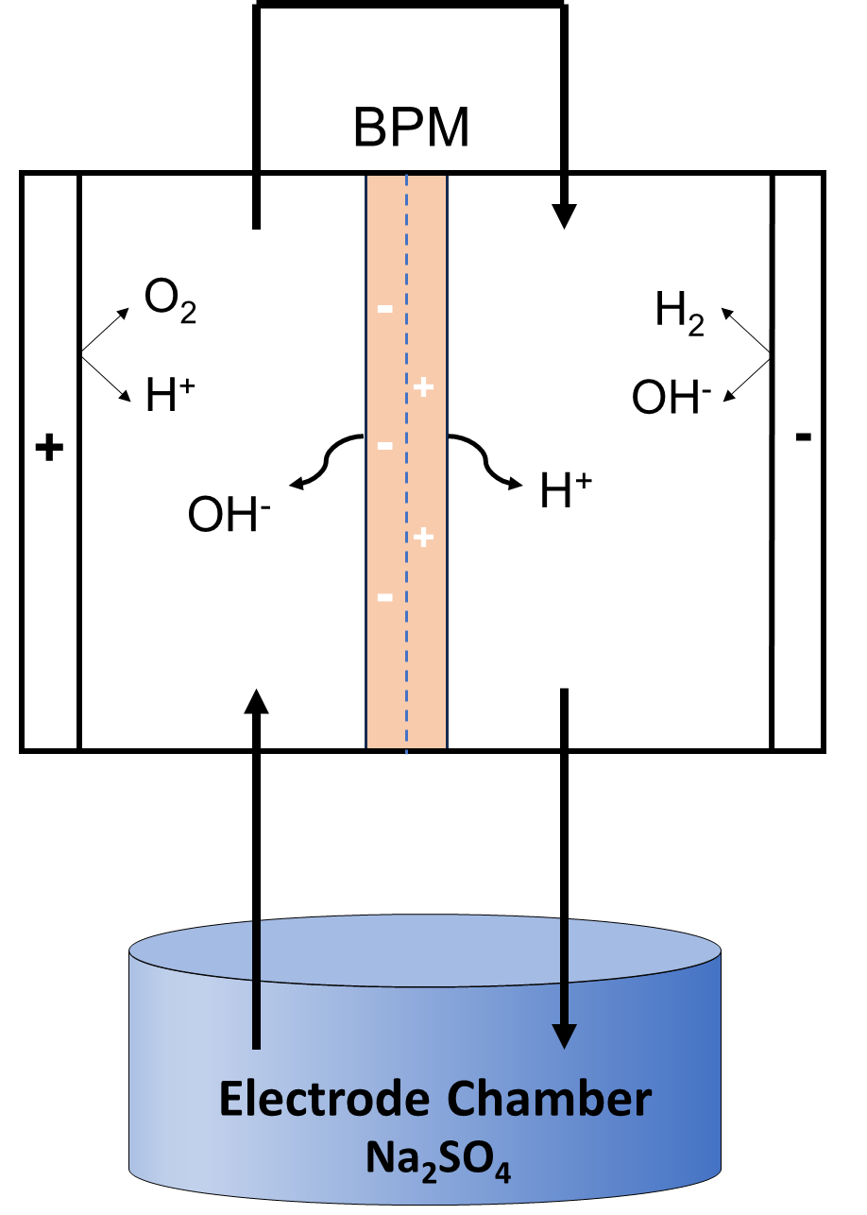
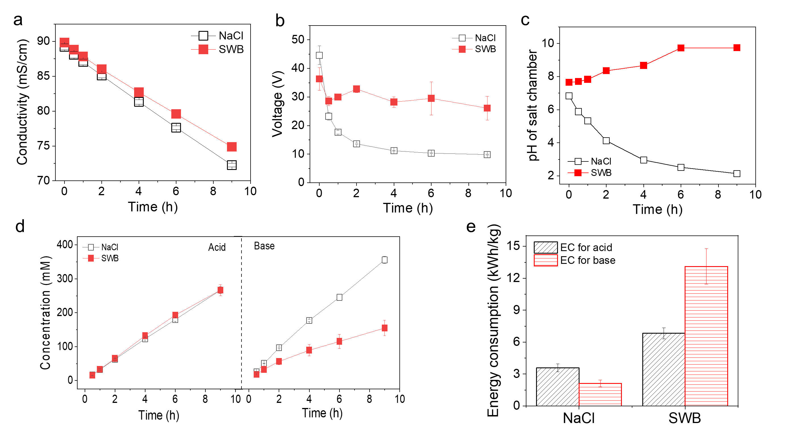
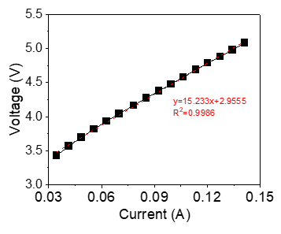
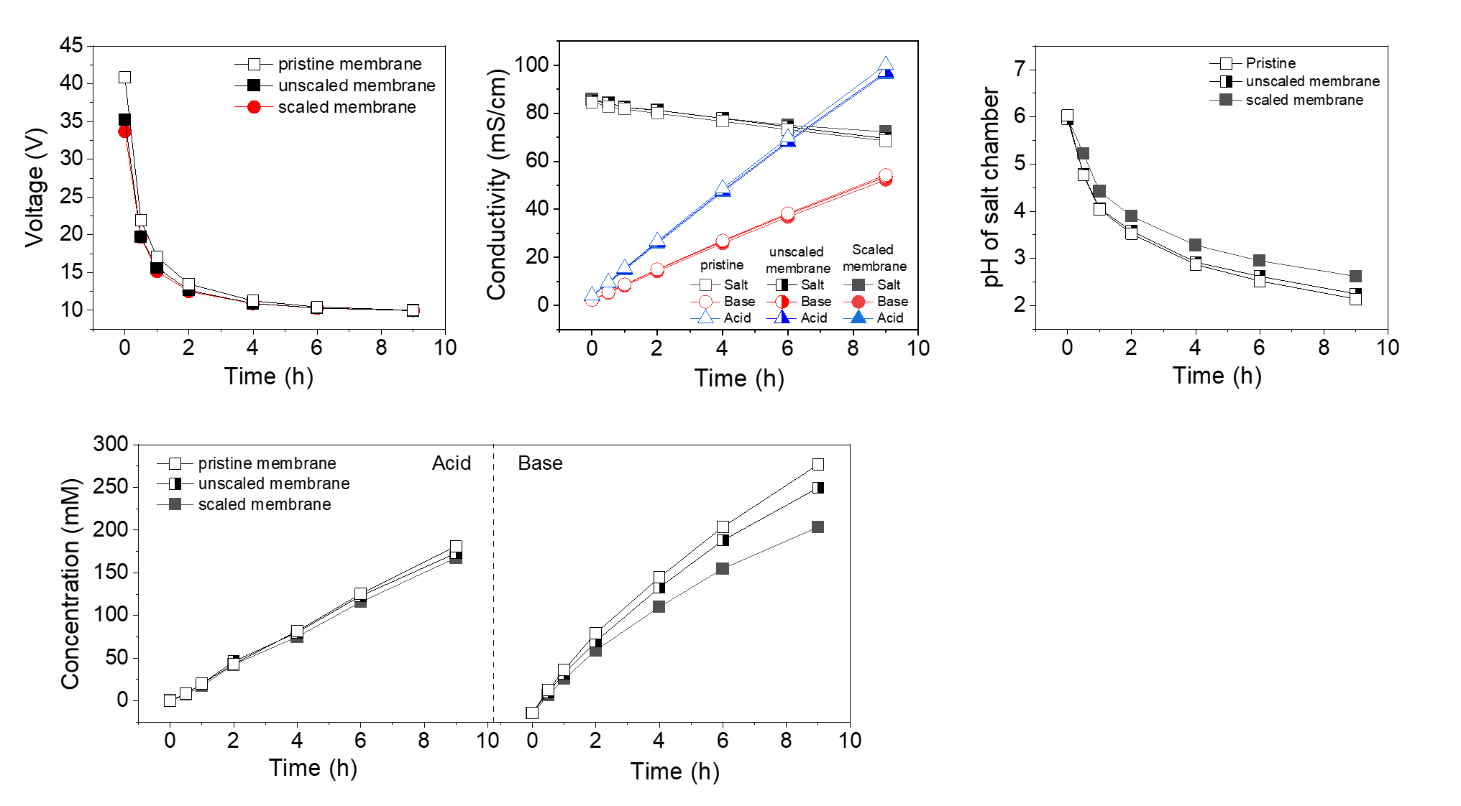
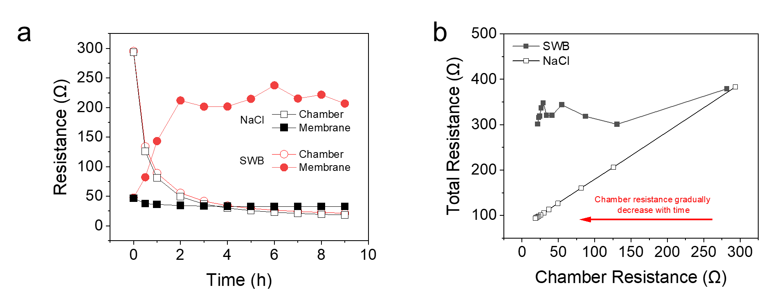
3.1.2 Effect of Scaling on BMED Performance
Conductivity, voltage, concentration of acid/base, pH of salt chamber, SEC
Voltage change → membrane resistance
Reversibility testing → The necessity to mitigate scaling on membrane
SI

Slide 9
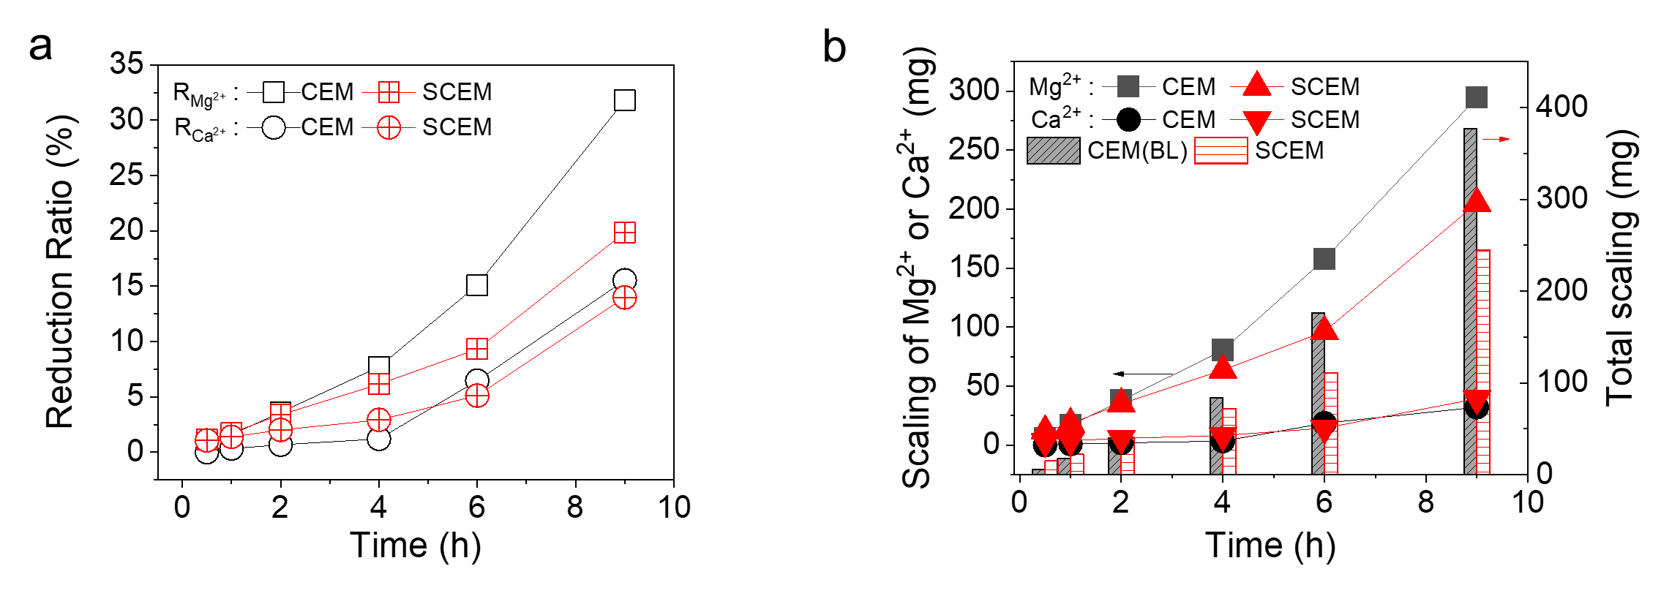
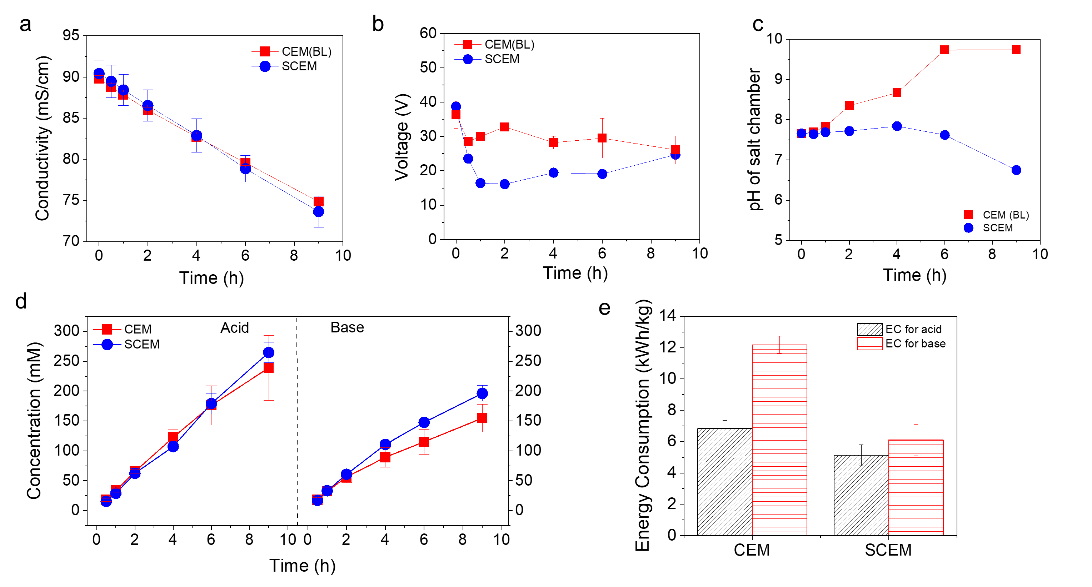
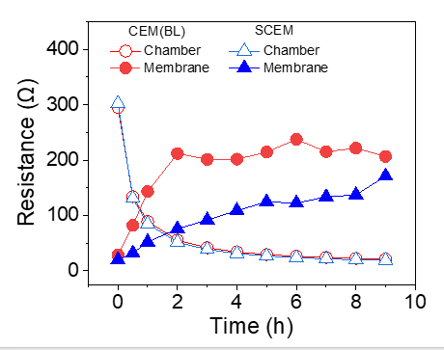
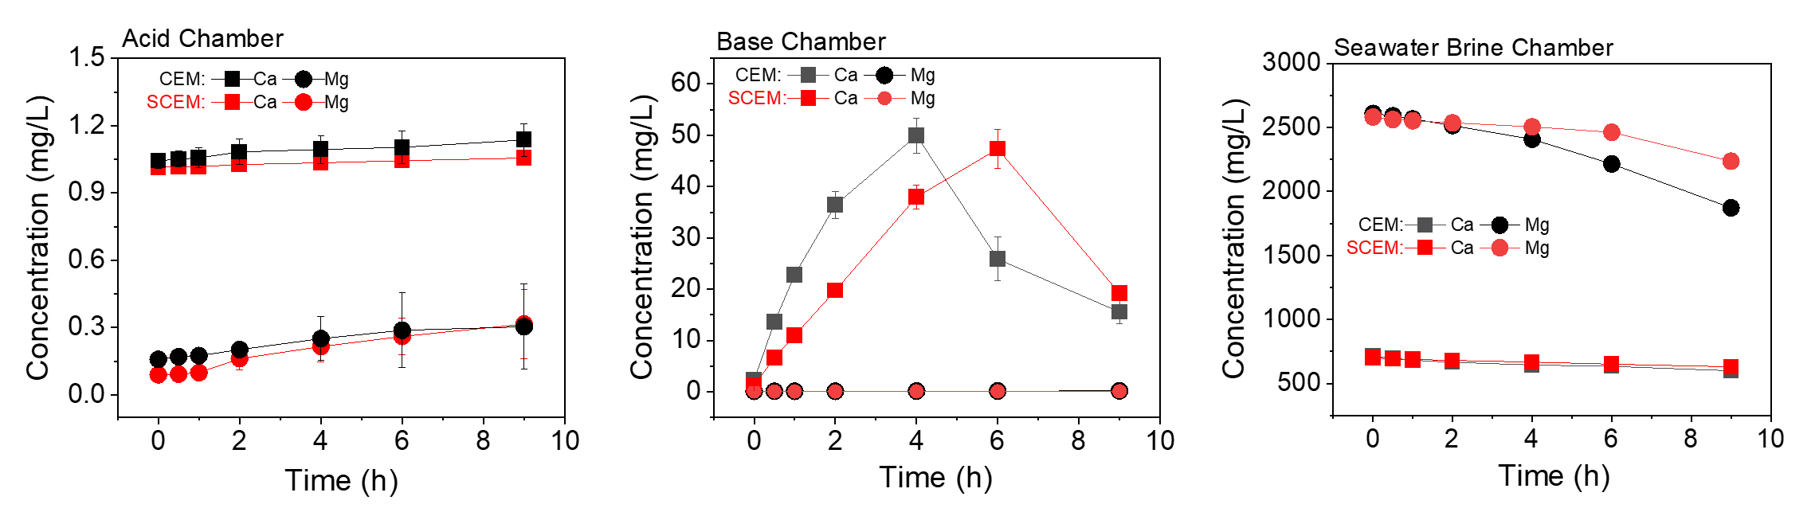
3.2 Effect of Mono-/di-valent selectivity of CEM on scaling
Quantification of scaling
- Performance
SI

Slide 10
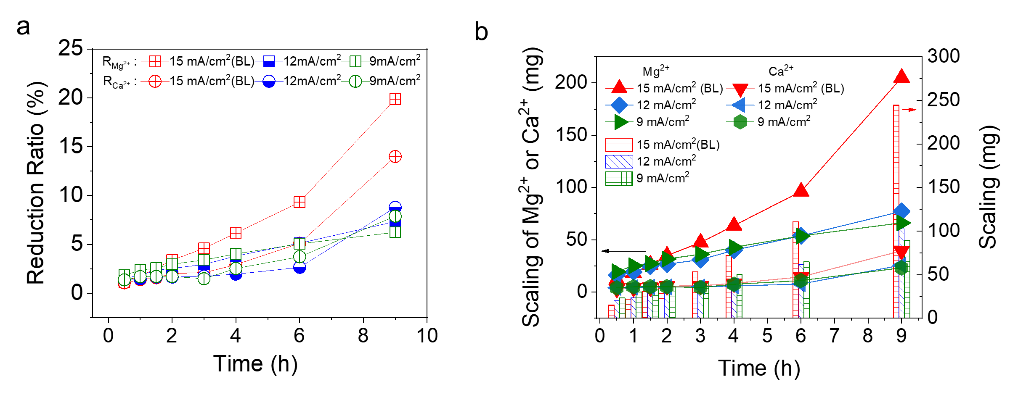
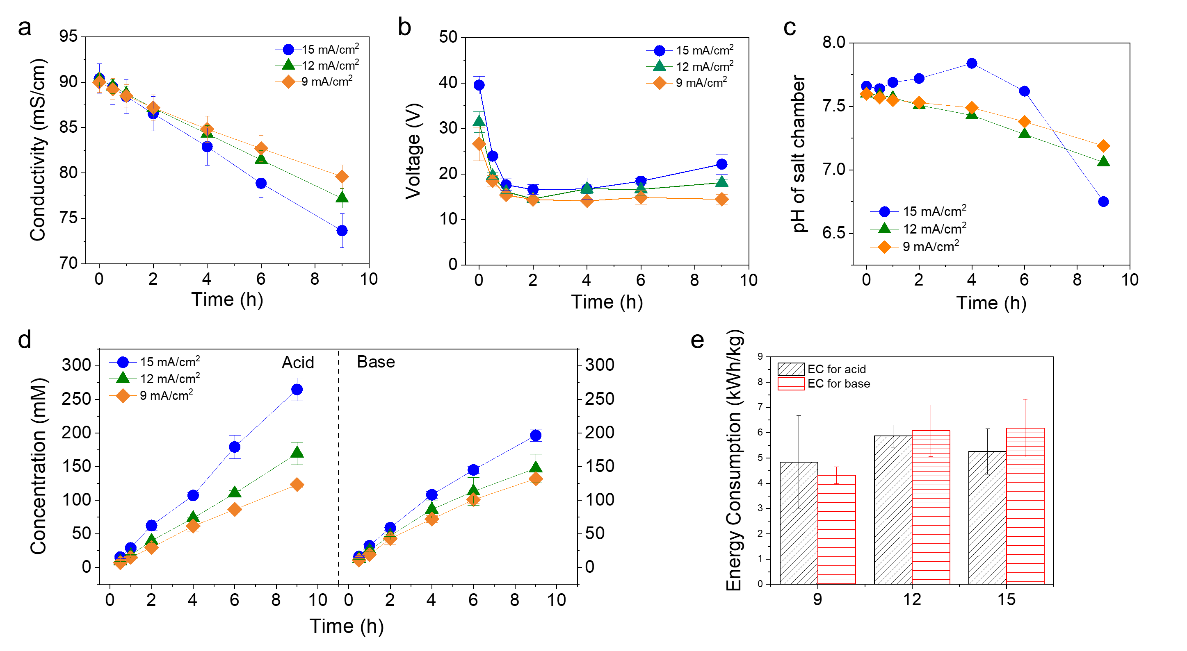
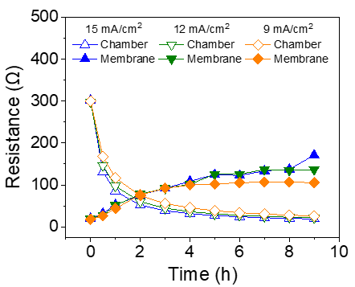
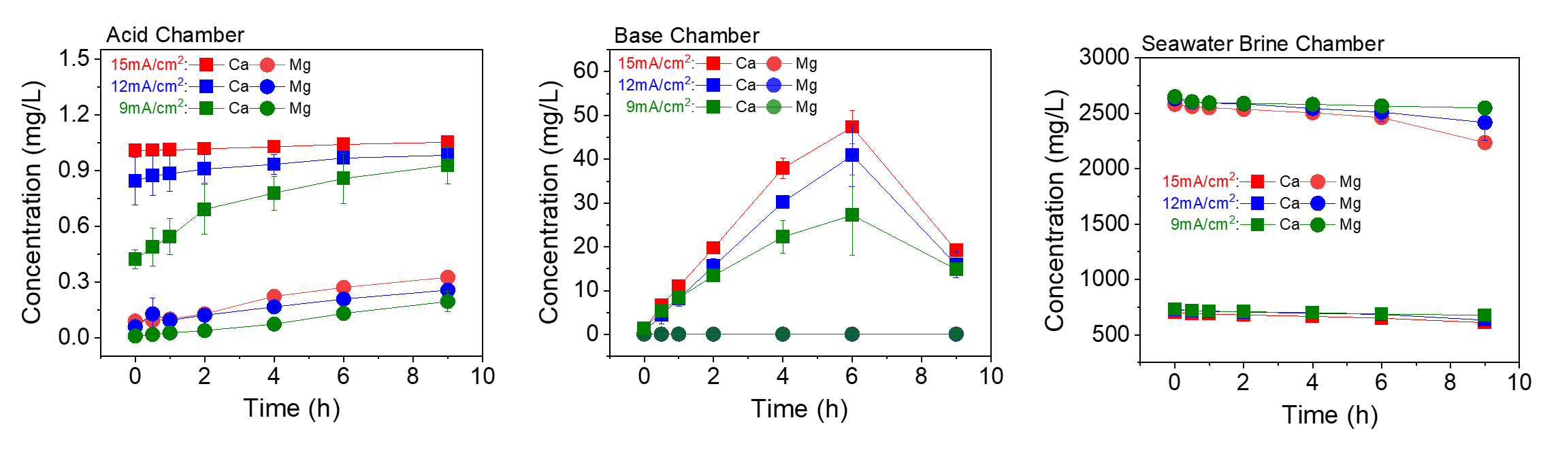
3.3 Effect of current density on scaling
Quantification of scaling
- Performance
SI

Slide 11
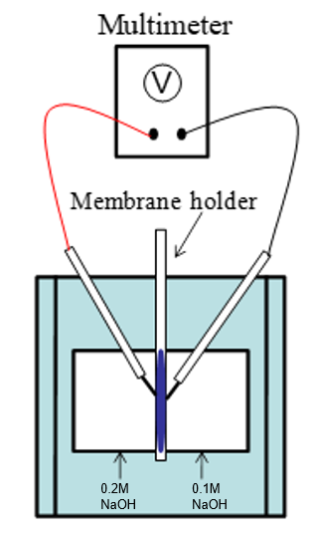
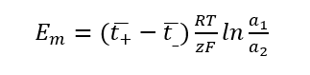
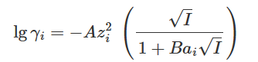
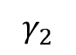
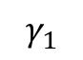
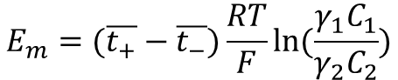
 | t₊
pristine CEM | 0.953841
scaled CEM | 0.911957
CEM-Ca | 0.941338
CEM-Mg | 0.953426
$$E_{m}=(\overline{t_{+}}−\overline{t_{−}})\frac{RT}{F}ln⁡(\frac{γ_{1}C_{1}}{γ_{2}C_{2}})$$
A=0.508 mol^{-1/2}dm^{3/2}
Transport number of counter-ion decreased for scaled membrane.
One of the reason for scaling on membrane facing SWBC is due to the enhanced OH⁻ leakage.
B=3.28 nm⁻¹mol^{-1/2}dm^{3/2}
ai (Na⁺)=0.4 nm
ai (OH⁻)=0.35 nm
0.2 M NaOH
$$γ_{1}$$
=0.713
 | Em, mV
pristine CEM | -14.52
scaled CEM | -13.18
CEM-Ca | -14.12
0.1 M NaOH
$$γ_{2}$$
=0.765
E₀=-15.9968 mV

Slide 12
Outline for ES&T

Slide 13
Introduction
Background of BMED. Applications. Review potential use of waste brine to valorize it for chemical production.
Potential scaling problems. Review previous studies on scaling in BMED
Define the research gap. Review how much understanding of scaling formation and evolution mechanisms in the literature. May also introduce scaling mechanisms in normal ED.
Objectives. Define objectives. Briefly introduce how you do it (methodology) – optional. The last sentence, significance of this study.

Slide 14
1. Characterization of scaling formed on different IEMs in BMED stack
Figure 1. Photo + FESEM-EDX
Clean membranes (NaCl) + scaled membranes (SWB)
Figure S1. Pristine membrane + NaCl membrane
Figure S2. photos of different beakers containing different solutions at the beginning of testing and at the end of testing (NaCl & SWB tests)
Table S1. Turbidity
Figure S3. type of scaling. XRD data

Slide 15
2. Influence of scaling on BMED performance (acid & base production)
Figure 2. (a) acid & base production performance (H+/OH- conc. vs. time); (b) pH change in salt chamber. (c) voltage vs. time; (d) resistance (chamber, membrane, total) vs. time
Figure S2. acid & base production rate as a function of time.
To further explain (a) and (b)
Figure S3. SEC. to further discuss the implication of (c) on energy consumption.
Figure S4. Solution conductivity in different chambers. (a) salt solution chamber, (b) acid, (c) base
To further explain Figure 2d.
A section to describe the methods to calculate resistances presented in Figure 2d.
Figure S5. related date for the calculation of resistances

Slide 16
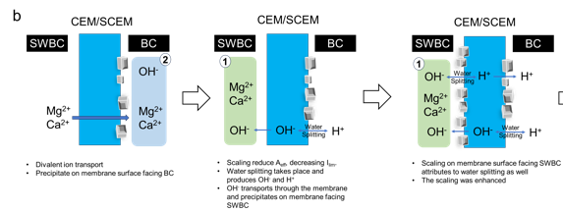
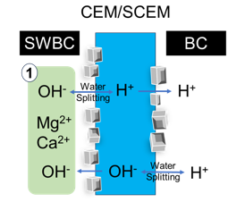
3. Scaling mechanisms
3.1. Overall crystallization in the bulk solution and on membranes
Figure 3. Ca & Mg reduction. (a) mass (Ca, Mg, total) vs. time; (b) reduction percentage vs. time
Bulk crystallization in solution (less likely to deposit on membrane due to lack of water flux and thus hydraulic drag force)
Surface crystallization on membrane (more likely to be the dominant scaling mechanisms on all the relevant membranes)
3.2. Mechanisms of scaling formation and evolution on CEM
Figure 4. (a) Ca & Mg conc. in salt chamber; (b) Ca & Mg conc. in base chamber.
Discuss together with pH change to explain scaling formation
Mg2+ + 2OH- → Mg(OH)2
Ca2+ + 2OH- → Ca(OH)2
Ca2+ + HCO3- + OH- → CaCO3 + H2O
Figure 5. (a) schematic diagram of the scaling formation mechanisms on CEM. Draw scaling on both sides. Label two mechanisms: (1) water splitting, (2) increased OH- leakage (decreased permselectivity). (b) transport number. To demonstrate OH- leakage will increase after scaling.
Based on salt chamber pH change, CEM surface facing base chamber may scale first. Discuss scaling evolution based on this sequence.
It is also likely CEM surface facing salt chamber scales first. This is not the focus on this study. We just want to elucidate the two major mechanisms.
Figure S? . Ca & Mg conc. in acid chamber
Figure S??. Cross section of IEMs. Did not observe crystallization in cross section within our detection limit

Slide 17
3.3. Scaling on BPM
Figure 6. (a) schematic diagram of BPM scaling mechanisms. (b) how will scaled BPM property change

Slide 18
4. Reversibility of BPMED
Figure 7. performance before scaling, after scaling, and after cleaning.

Slide 19
Implications
Briefly summarize what has been done and the findings in this study
Discuss implications.

